Slide 1
Infrastruktura Big Data

Slide 2
Agenda
Azure Storage
Azure Data Lake Storage Gen2, Blob Storage
Narzędzie ETL/ELT
Data factory
Batch Processing & Stream Processing
Azure Databricks (Big Data)
Stream analytics
Data Warehouse/Lakehouse
Azure Synapse/MS Fabric
Monitoring
Azure Monitor
Data security
Azure role-based access control
POSIX-like Access Control

Slide 3
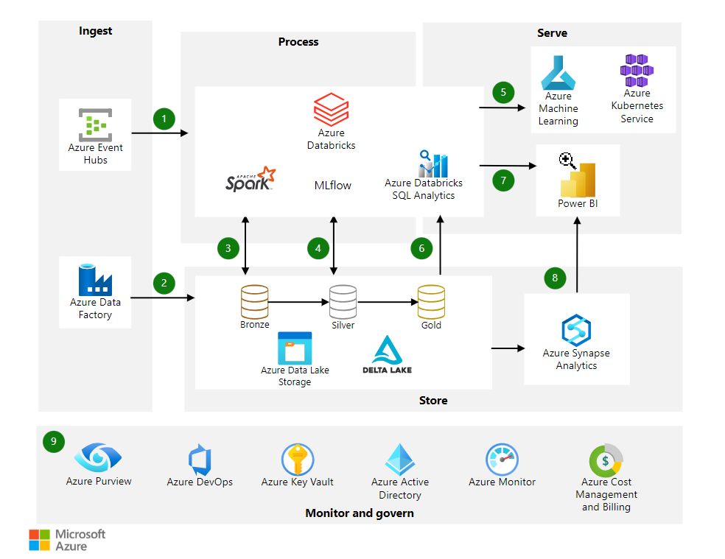
Przykładowa architektura

Slide 4
Magazyn danych

Slide 5
Data Lake
What data lake is ?
A data lake is a system or repository of data stored in its natural/raw format,[1] usually
object blobs or files.
A data lake can include structured data from relational databases (rows and columns), semi-structured data (CSV, logs, XML, JSON), unstructured data (emails, documents, PDFs) and binary data (images, audio, video).

Slide 6
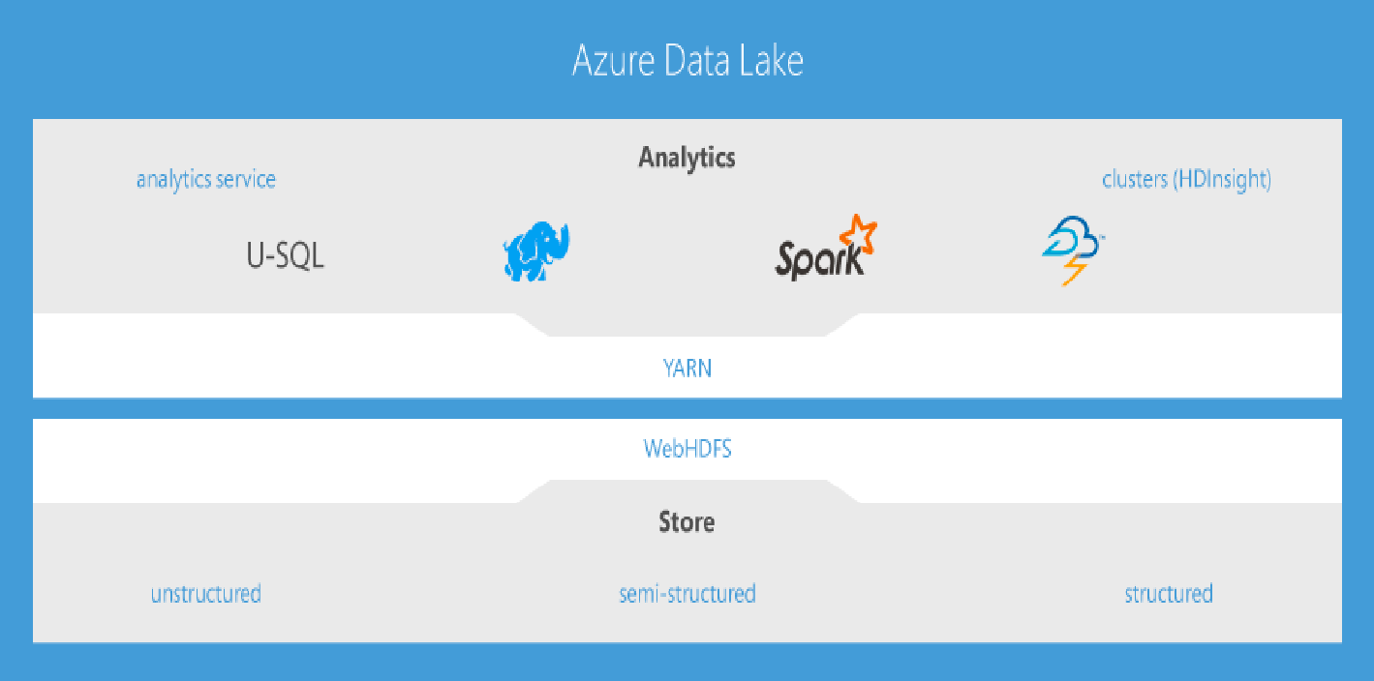
Azure Data Lake

Slide 7
Data Lake GEN 2 vs Azure Blob Storage
Hadoop compatible access: Data Lake Storage Gen2 allows you to manage and access data
just as you would with a Hadoop Distributed File System (HDFS).
ABFS driver is available within all Apache Hadoop environments, including Azure HDInsight, Azure
Databricks, and SQL Data Warehouse to access data stored in Data Lake Storage Gen2.
A superset of POSIX permissions: The security model for Data Lake Gen2 supports ACL and
POSIX permissions along with some extra granularity specific to Data Lake Storage Gen2.
Settings may be configured through Storage Explorer or through frameworks like Hive and
Spark.
Optimized driver: The ABFS driver is optimized specifically for big data analytics. The
corresponding REST APIs are surfaced through the endpoint dfs.core.windows.net.

Slide 8
Narzędzie ETL/ELT (Orkiestracja)

Slide 9
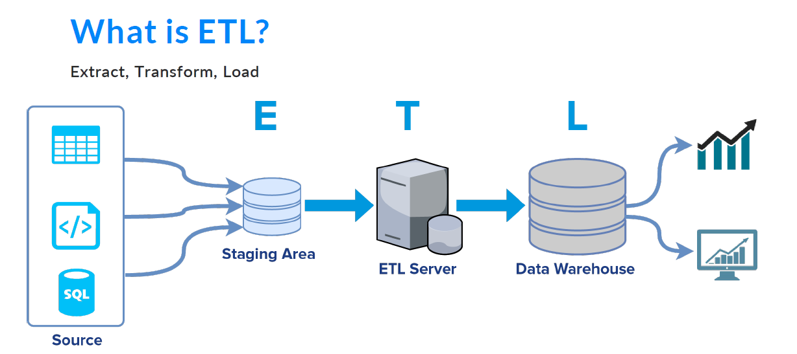

Slide 10
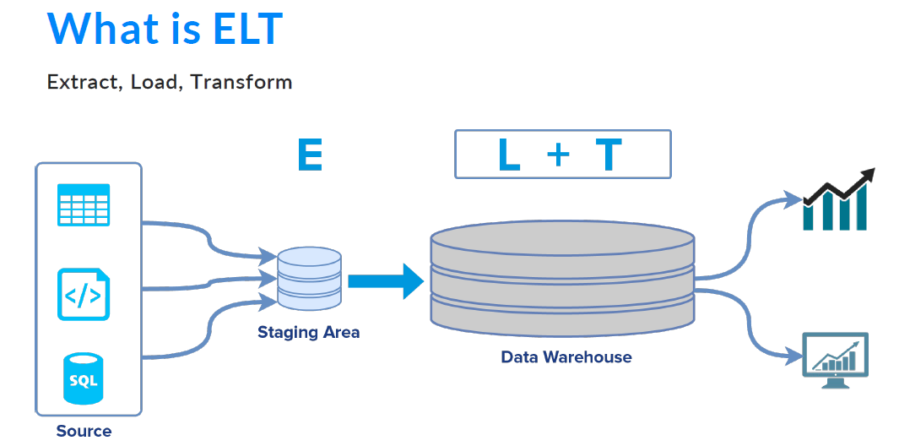

Slide 11
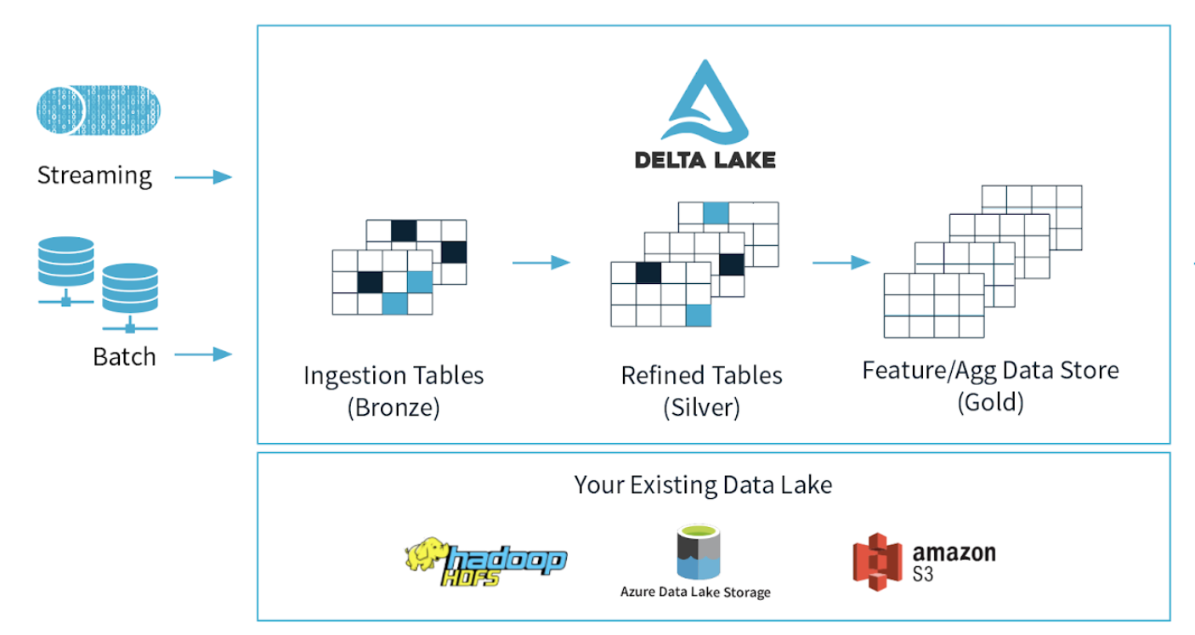

Slide 12
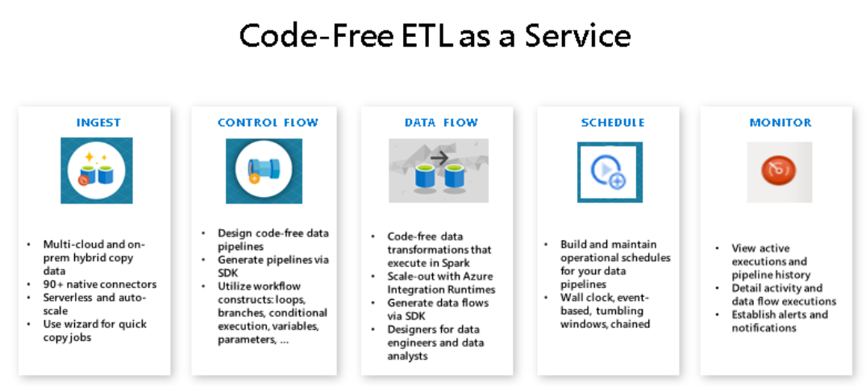
What it is Azure Data Factory ?
Azure Data Factory is an orchestration service to easily transform and move data.
You can enrich and process data.
It is used for creating ETL and ELT processes.
In Data Factory you can use UI editor to setup data pipeline. (no coding required)

Slide 13
ADF components
• Dataset – reference to your data source
• Activity – a processing step. Eg. copy activity, run SQL query, execute function and
more.
• Pipeline - group of activates
• Linked Service – a connection string to external resource
• Control flow – orchestration of pipeline activities
• Data flow – a tool to prepare or transform your data without any code
• Monitor - In azure Data Factory you can monitor your status of task, debug pipelines
and explore errors in failed tasks.
• Integration runtime – compute resources needed to perform tasks defined in ADF
• Triggers
• Git

Slide 14
Batch Processing & Stream Processing

Slide 15
Azure Databricks
• Data analytics service based on Apache Spark
• Allows you to set-up and configure Apache Spark environment
• Uses interactive notebooks
• Allows for team collaboration
• Integrates with Azure AD
• Auto scalable
• Supports languages: Python, R, Scala, SQL
• Used both in batch and real-time processing
• Supports Machine learning tasks (TensorFlow, Pytorch, SkLearn)

Slide 16
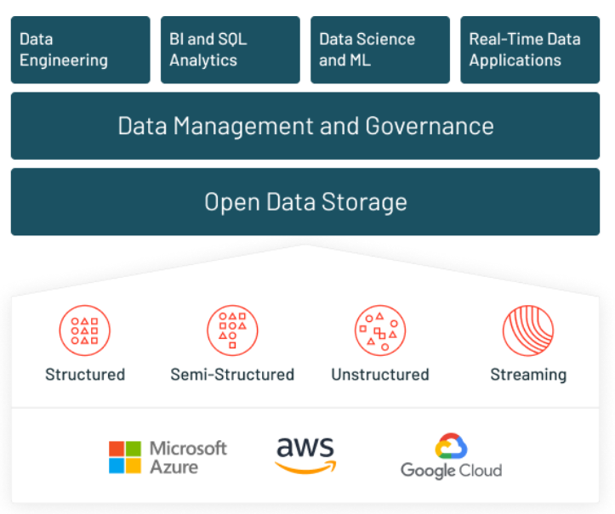
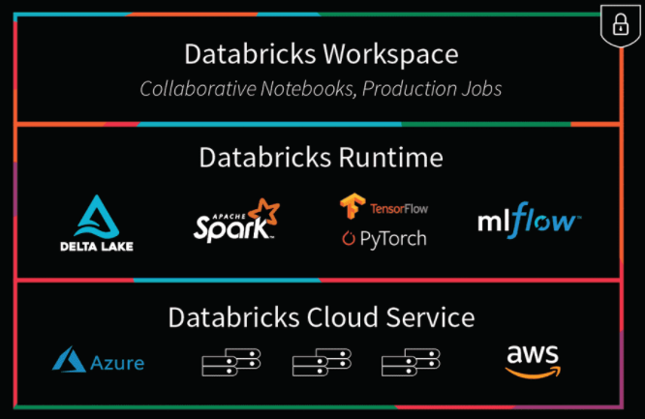
Databricks Platform
https://databricks.com/product/data-lakehouse

Slide 17
Azure Databricks data sources
• SQL Database with JDBC
• Azure Blob Storage
• Azure Data Lake
• Azure Cosmos DB
• SQL Data Warehouse
• Couchbase
• ElasticSearch
• Hive Tables
• Files (Avro, Json, CSV, Parquet)
Archives (LZO, ZIP)
• Redis
• Neo4j
• Snowflake
• Riak Time Series
• Cassandra
• Kafka

Slide 18


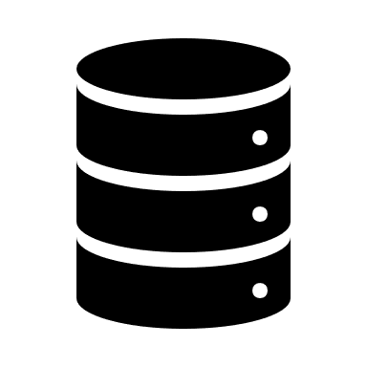
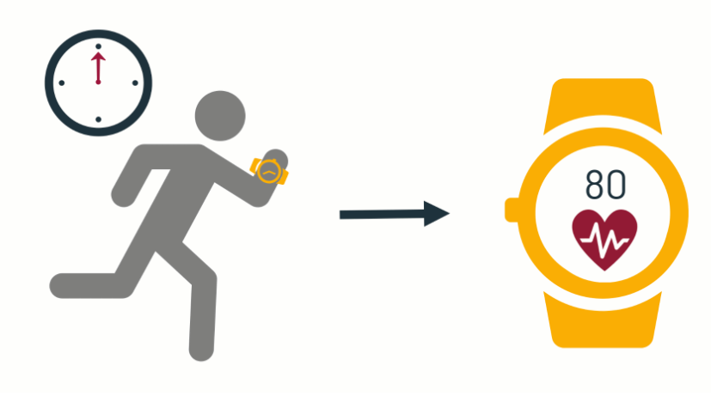
Databricks Batch and Stream
Batch
Streaming
What is it?
Batch data is data that we have in storage and that we process all at once, or in a batch.
What is it?
On the other hand, we have streaming data. Streaming data is data that is being continually produced by one or more sources and therefore must be processed incrementally as it arrives.

Slide 19
Stream Analytics
Azure Stream Analytics Azure Stream Analytics is designed to process and analyze real-time data.
It’s serverless. To process data you can use SQL and extend its with custom code. Also you can use build in machine learning capabilities to detect anomalies and more.
Typical scenarios:
• Telemetry data
• IoT
• Predictive maintenance
• Anomaly detection
• Weblogs

Slide 20
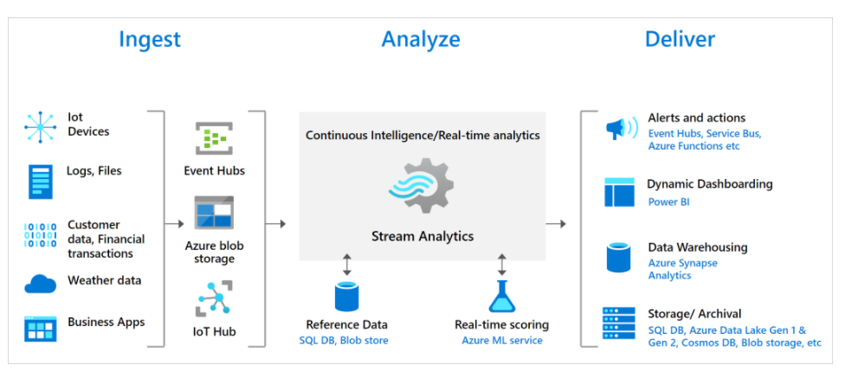
Stream Analytics
Notes:
Raspberry Pi Azure IoT Web Simulator (azure-samples.github.io)

Slide 21
Stream Analytics Komponenty
• Job – defines a single data flow: Input -> query -> output
• Job input – data source for Azure SA.
Available options:
• Azure Event Hub
• Azure IoT Hub
• Blob Storage
• Job output – a place when you can store results of Stream Analytics query. Available options:
• Azure Datalake
• Azure SQL
• Event Hub
• Power BI
• Table Storage
• Azure Service Bus
• CosmosDB
• Azure Function
• Query – defines how data should be analyzed, transformed.

Slide 22
Databricks i Application Insights Logs
https://docs.microsoft.com/en-us/azure/architecture/databricks-monitoring/application-logs
https://github.com/microsoft/ApplicationInsights-Java
https://docs.microsoft.com/en-us/azure/architecture/databricks-monitoring/application-logs
Create Log Analytics Workspace
Create Application Insights
Build Jars
Load Jars to dbfs
dbfs:/databricks/appinsights/applicationinsights-core-2.6.1.jar
dbfs:/databricks/appinsights/applicationinsights-logging-log4j1_2-2.6.1.jar
https://github.com/microsoft/ApplicationInsights-Java/releases/download/2.6.1/applicationinsights- core-2.6.1.jar
https://github.com/microsoft/ApplicationInsights-Java/releases/download/2.6.1/applicationinsights- logging-log4j1_2-2.6.1.jar
Add bash script to cluster Init scripts lub Global Init Scripts

Slide 23
Data Warehouse

Slide 24
Synapse Analytics
• Stores data in relational tables/ability to analyse raw files
• Uses columnar storage
• Distributed
• BigData analytics
• Provisioned or serverless resources
• Storage and compute are independent

Slide 25
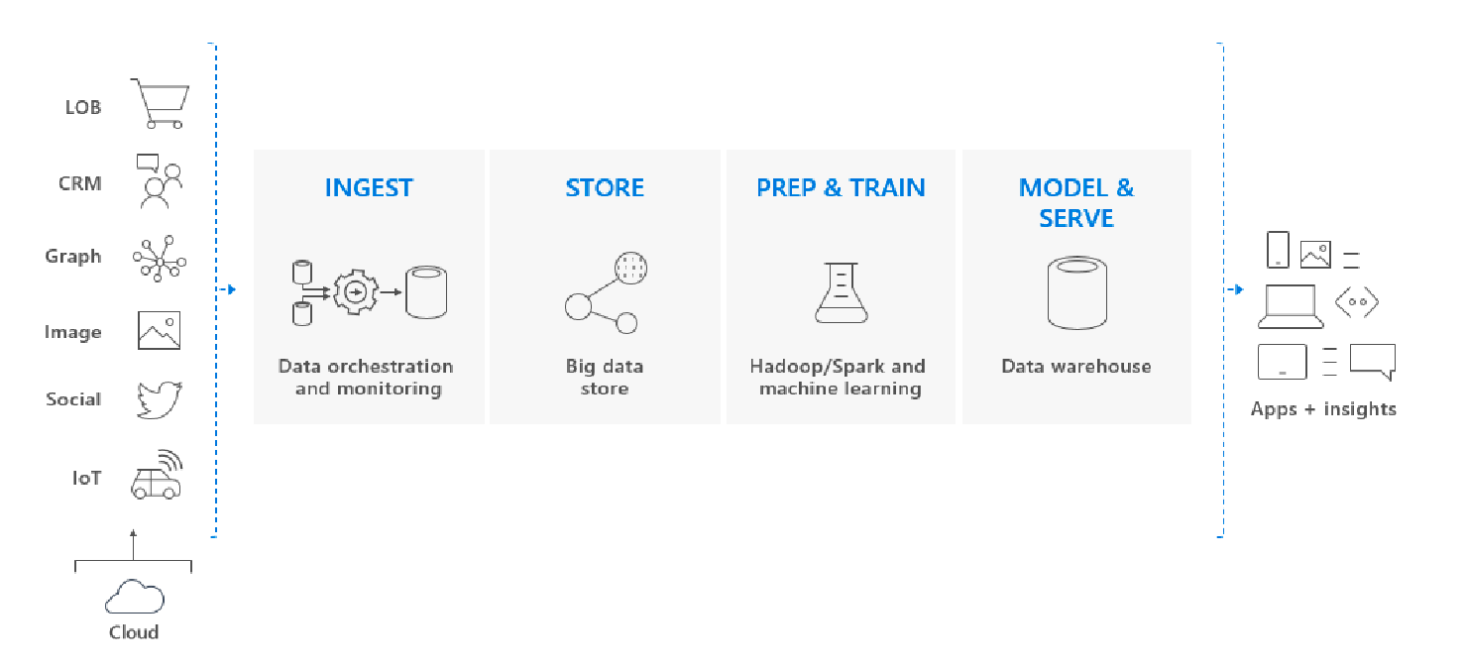
Azure Synapse Analytics użycie – data warehousing

Slide 26
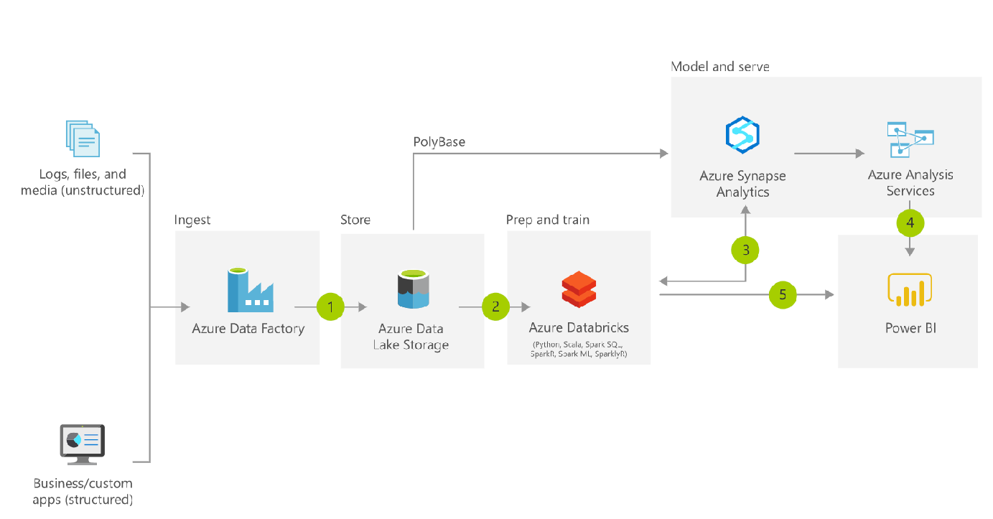
Azure Synapse Analytics – modern data warehouse

Slide 27
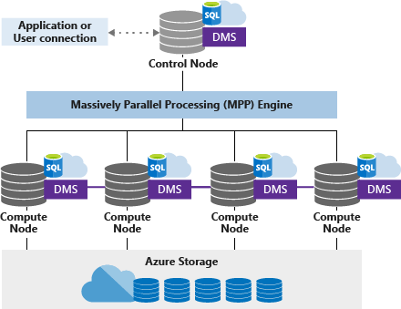
Azure Synapse Analytics Architecture

Slide 28
Azure Synapse Analytics komponenty
• SQL Analytics (previously Azure Data warehouse)
• Spark
• Data integration
• Studio
• Workload management
• On-demand query

Slide 29
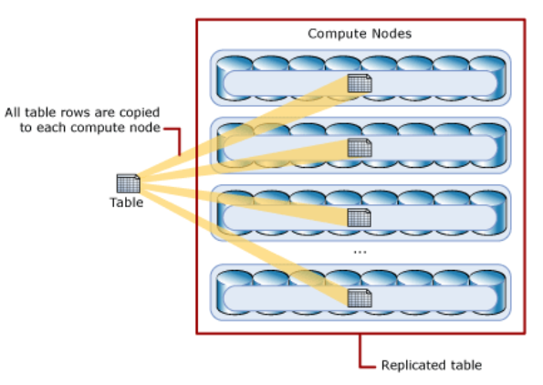
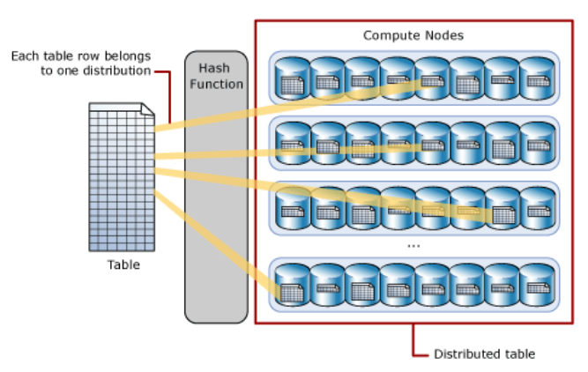
Dystrybucja Tabel
Tabele są rodzielane „shared distributions”
Hash: Każdy wiersz jest przypisany do jednego węzła na podstawie kolumny
Round Robin: dane są równo rozdzielone na węźle
Replicated: kopia rozesłana na węźle
Hash: Każdy wiersz jest przypisany do jednego węzła na podstawie kolumny

Slide 30
Synapse Analytics - Ładowanie danych
• BCP
• SQL BulkCopy API
• COPY statement
• PolyBase

Slide 31
COPY statement (preview)
• Similar performance to PolyBase
• Aspires to load data faster than PolyBase
• Supports CSV, ORC, PARQUET
COPY INTO test_1 FROM 'https://myaccount.blob.core.windows.net/myblobcontainer/folder1/’
WITH
(
FILE_TYPE = 'CSV’,
CREDENTIAL=(IDENTITY= 'Shared Access Signature', SECRET='<Your_SAS_Token>’),
FIELDQUOTE = '”’,
FIELDTERMINATOR=';’,
ROWTERMINATOR='0X0A’,
ENCODING = 'UTF8’,
DATEFORMAT = 'ymd’,
MAXERRORS = 10,
ERRORFILE = '/errorsfolder/’,
IDENTITY_INSERT = 'ON’
)

Slide 32
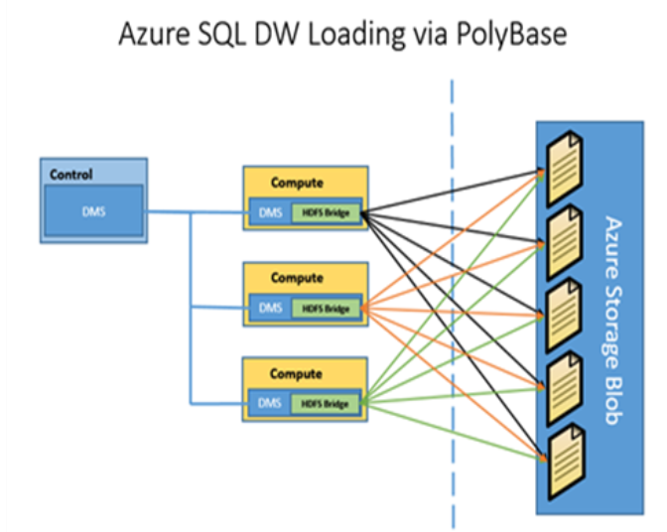
PolyBase
• Best and fastest way to load data into Azure SA
• Allows you to read data from external data sources
• Azure Blob Storage
• Azure Data lake
• Hadoop
• Is a part of T-SQL language
• Benefits from Massively Parallel Processing (MPP)
Supported file formats:
• Text files (UTF-8, UTF-16)
• RC file
• ORC
• Parquet
• Compressed files (gzip, zlib, snappy)
• JSON, XML are not supported
https://techcommunity.microsoft.com/t5/datacat/azure-sql-data-warehouse-loading-patterns-and-strategies/ba-p/305456

Slide 33
Implementing Analytics Solutions Using Microsoft Fabric

Slide 34
Azure MS Fabric komponenty
Lakehouses
Data warehouses
Notebooks
Dataflows
Data pipelines
Semantic models
Reports
Data modeling
Data transformation
Git-based source control
Exploratory analytics
Languages, (SQL), Data Analysis Expressions (DAX), and PySpark

Slide 35
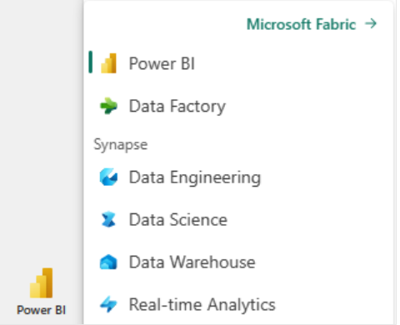
Azure MS Fabric

Slide 36
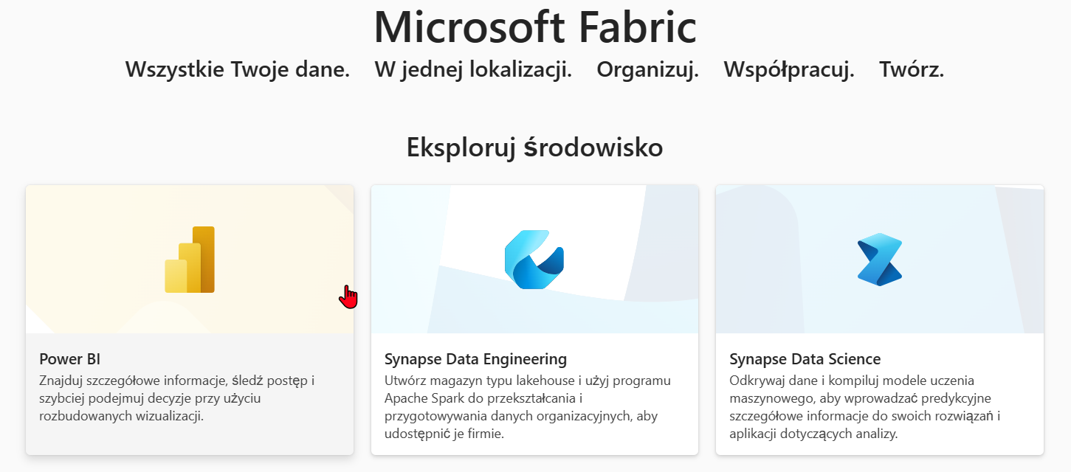
Azure MS Fabric

Slide 37
Azure Monitor

Slide 38
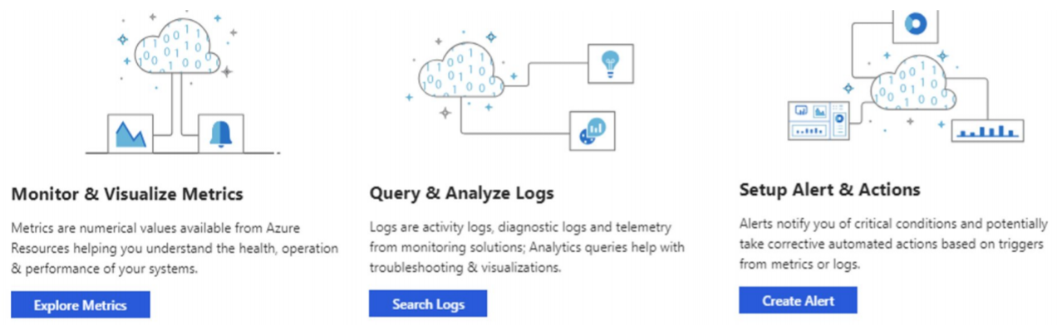
Azure Monitor

Slide 39
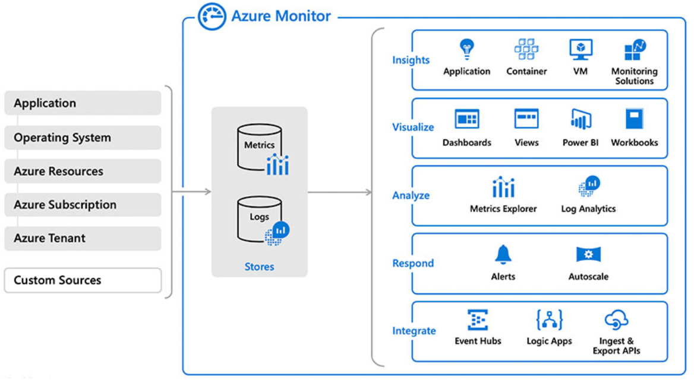
What is Azure Monitor
Azure Monitor collects monitoring telemetry data from multiple on-premises and Azure sources.

Slide 40
Bezpieczeństwo danych

Slide 41
Azure Security Center
Protect against threats
Security Center includes automatic, native integration with Microsoft Defender Advanced Threat Protection. Windows and Linux machines are fully integrated with Security Center's recommendations and assessments.
Continuous assessments
Security Center makes mitigating your security alerts one step easier, by adding a Secure Score. The Secure Scores are now associated with each recommendation you receive to help you understand how important each recommendation is to your overall security posture.
Protect PaaS
detect threats targeting Azure services including Azure App Service, Azure SQL, Azure Storage Account, and more data services
Block brute force attacks
By reducing access to virtual machine ports, using the just-in-time VM access, you can harden your network by preventing unnecessary access

Slide 42
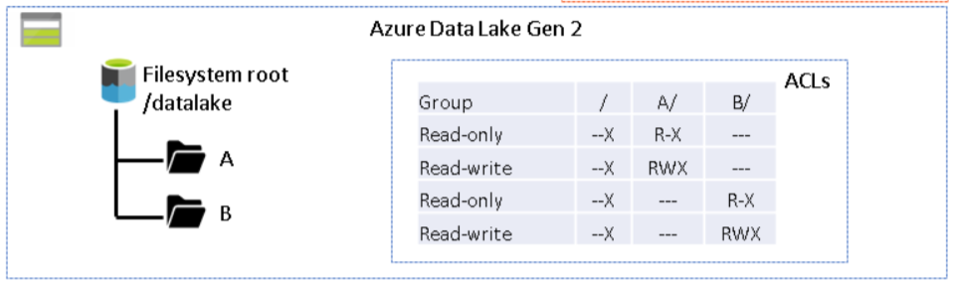
Storage Access
Types of access
Private (no anonymous access)
Blob allows for anonymous access but read only to individual blobs
Container, read only but for the whole container
Azure role-based access control (Azure RBAC) and POSIX-like access control lists (ACLs).

Slide 43
Pytania ?

